Slide 1
European Association of Preventive Cardiology (EAPC)

Slide 2

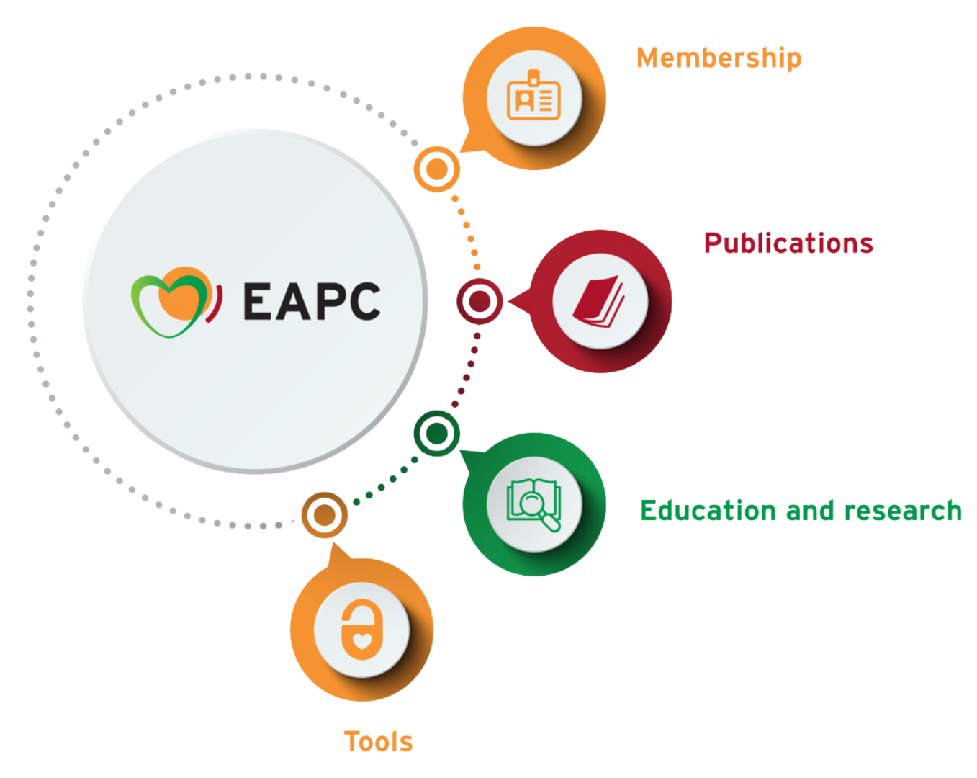
European
Association of
Preventive
Cardiology
Our mission
Promote excellence in research, practice, education and policy in cardiovascular health, primary and secondary prevention

Slide 3
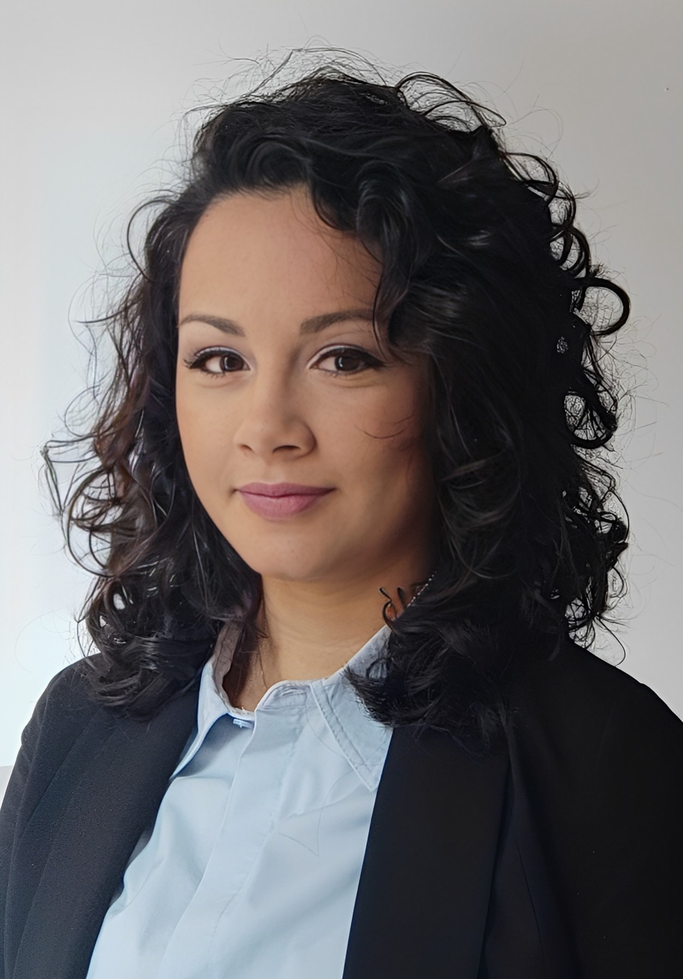

EAPC Young Ambassadors
Francesca Graziano
Heart and Vascular Centre, Department of Sports Medicine, Semmelweis University, Budapest. Department of Cardiac, Thoracic and Vascular Sciences and Public Health, University of Padova, Italy
26 Active Ambassadors
The EAPC Young Ambassadors main missions are to :
• Promote the EAPC Young Community and its activities
• Facilitate the access of young physicians in their country to educational opportunities offered by the EAPC
• Establish a national network of young cardiologists in their country who are interested in preventive cardiology

Slide 4
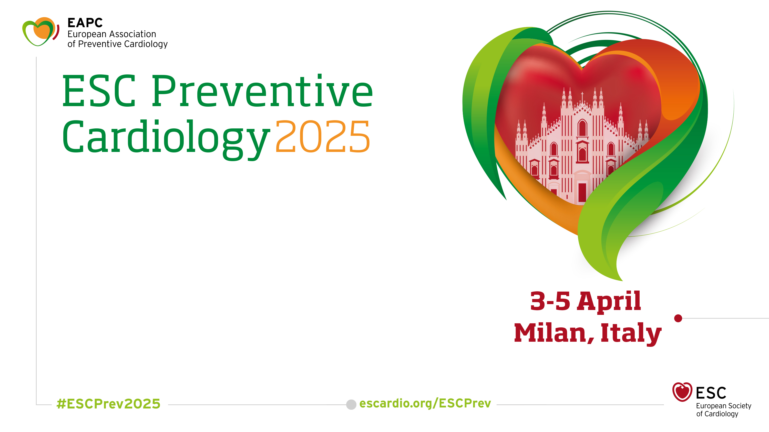
Risk factors realities in 2025
21 Jan 2025 Late-Breaking Science submission
03 Feb 2025 Early registration fee
Special fees for EAPC Silver members in training : save up to 100€

Slide 5
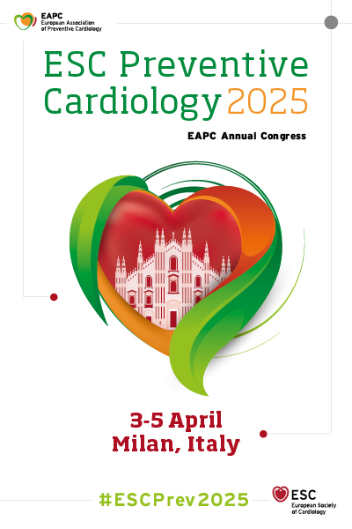
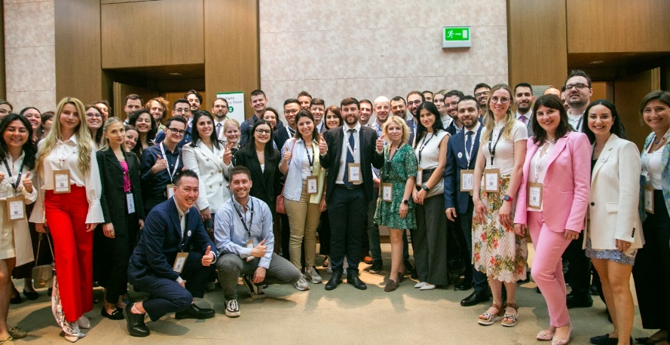
EAPC Young Community Open Meetings at ESC Preventive Cardiology

Slide 6
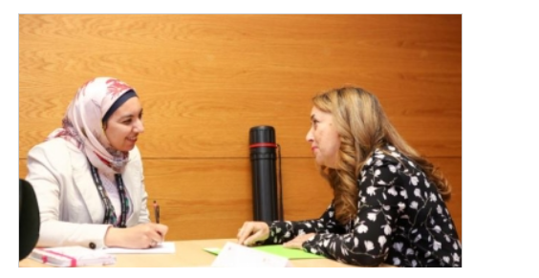
EAPC Career Café
Get career advice in ESC Preventive Cardiology from key experts.
The EAPC Career Café connects young healthcare professionals and international experts during one-on-one in-person meetings. Selected applicants will receive career development advice and recommendations from seasoned and successful leaders in their fields.
Open to
Healthcare professionals under 40 years old or in training.
Registered to ESC Preventive Cardiology 2025
EAPC Silver members
Applications will open in February 2025

Slide 7

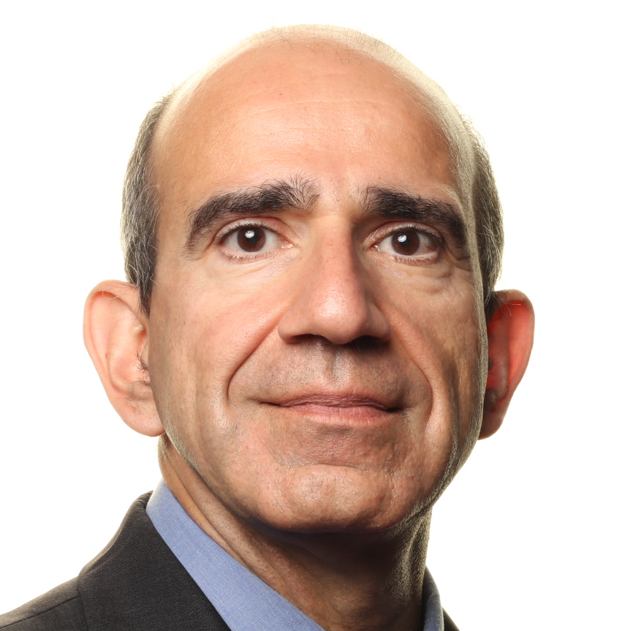
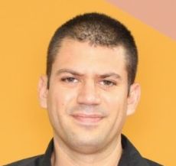
EAPC Journal Club
Targeting obesity to modify cardiovascular risk
With Prof. Pedro Marques Vidal & Dr. Gal Tsaban
30 January 2025
17:00 -18:00 CET
Register now

Slide 8

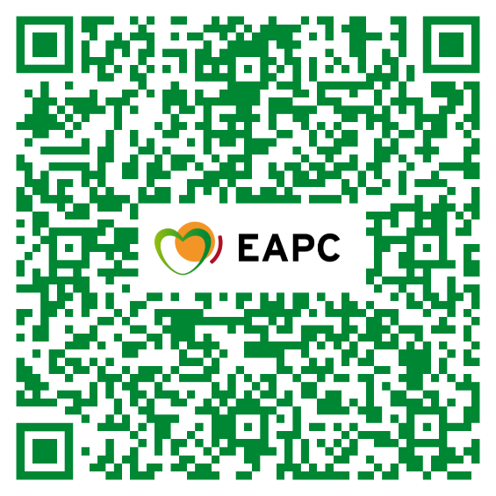
Get ready
Next exam 13 May 2025

Slide 9
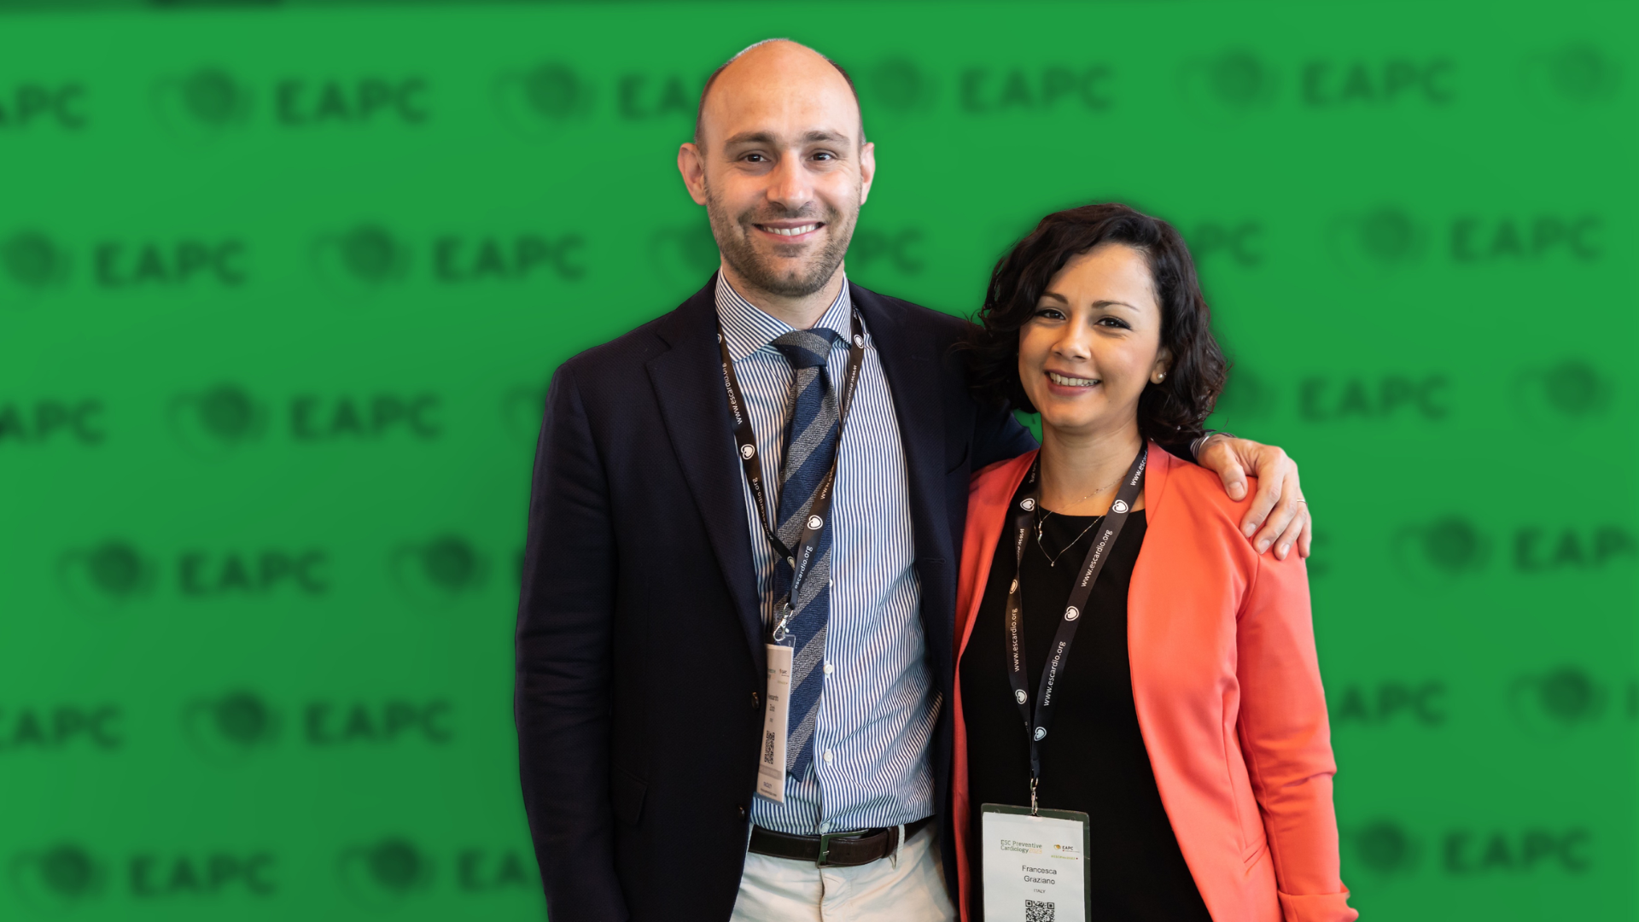



Under 40?
Connect
and
expand
your network
All year long
Young Ambassador Network
EAPC Young Community
EAPC Facebook group

Slide 10

Standard fee: €150
Aged under 40, student or in training, PhD researcher, nurse or allied professional: €75

Slide 11
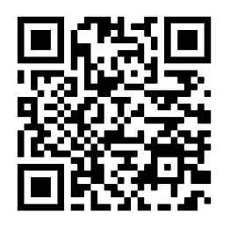

EAPC
Journal Club
Future event: Targeting Obesity to modify cardiovascular risk
Organised by the EAPC Young Community

